Slide 1


Open Data + Data Publishing
Data-Driven Scholarship Institute
Hong Kong University
Nicholas Weber
Notes:
What up doe?
This morning I’m going to talk about a very practical set of topics - in particular opend ata and data publishing…

Slide 2
Overview
Publishing data?
Open Data
Licensing data for reuse
Trusted digital repositories
Persistent identifiers
URLs, ARKs, DOIs - who cares?
Link rot
Tracking and tracing data use
Notes:
The overview will look something like this -

Slide 3
Open Data
It can be summed up in the statement that:
“Open means anyone can freely access, use, modify, and share for any purpose(subject, at most, to requirements that preserve provenance and openness).”
Put most succinctly:
“Open data and content can be freely used, modified, and shared by anyone for any purpose”
Open Knowledge Foundation: http://opendefinition.org/
Notes:
What is open data – I particularly like this set of definitons – 1. What is open? 2. What is open data?

Slide 4
Why do we care?
Data are often different digital objects playing a role in scholarship (music, digitized manuscripts, maps, etc).
Diversity of roles that can be played depends on ability to be reused…
Open data is a means to say – PLAY ANY ROLE YOU LIKE, you crazy information objects!

Slide 5
Data Licensing…
Creates protections for intellectual property holder
Guides / regulates reuse
Context specific – different jurisdictions handle licensing / copyright of ’data’ differently
Databases – some copyright protection in USA and EU
USA – NO Sweat-of-the-Brow doctrine. (17. U.S.C. § 101 + 17 U.S.C. § 103(b))
EU – 1996 Database Directive :
Provides that databases shall be protected under copyright law where the selection or arrangement of the contents constitutes the author's own intellectual creation. (similar to USA)
Provides for a sui generis right that prohibits the extraction or reutilization of any database in which there has been a substantial investment in either obtaining, verification, or presentation of the data contents. Under this second right, there is no requirement for creativity or originality.
Notes:
One of the ways to establish or gurantee open data are through licenses which attach to a resource….
Typically a license creates protection for the intellectual property of an individual by setting up how and in what ways those resources can be used...
So it is important to note that - data – that is facts that exist about the world – cannot generally be copyrighted... However, structured information like databases – or as Doc D desribed the HathiTrust collection – can and do have some different proections...
In the USA – we have what is known as a sweat of the brow doctorine... This was established in case law which pitted a a phone company vs a phone book publisher...
In the EU – there is a very similar set of laws – that provides copyright protections for database creators where there is substnatial work in the selection, arrangement or processing of its contents...

Slide 6
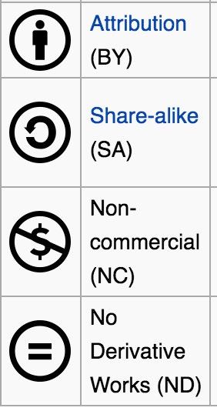
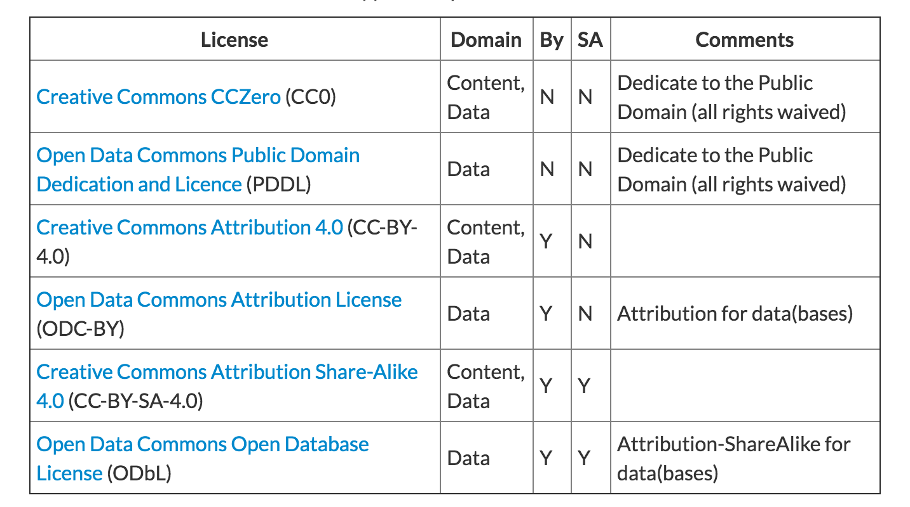
Data licensing- In practice
Domain = Domain of application, i.e. what type of material this license should/can be applied to.
http://opendefinition.org/licenses/
Notes:
Here is a general list of licenses which can be attached to Open Data sets… You see that most have some distinction between four dimmensions...
Attirbution, share alike... Non-commercial use... And no derivative works...

Slide 7
Other licenses
Against DRM
Creative Commons Attribution versions 1.0-3.0
Creative Commons Attribution-Share Alike versions 1.0-3.0
Data license Germany – attribution – version 2.0
Data license Germany – Zero – version 2.0
Design Science License
EFF Open Audio License
Free Art License (FAL)
GNU Free Documentation License (GNU FDL)
MirOS License
Open Government License Canada 2.0
Open Government Licesnse United Kingdom 2.0and 3.0
Talis Community License
Notes:
Some others…

Slide 8
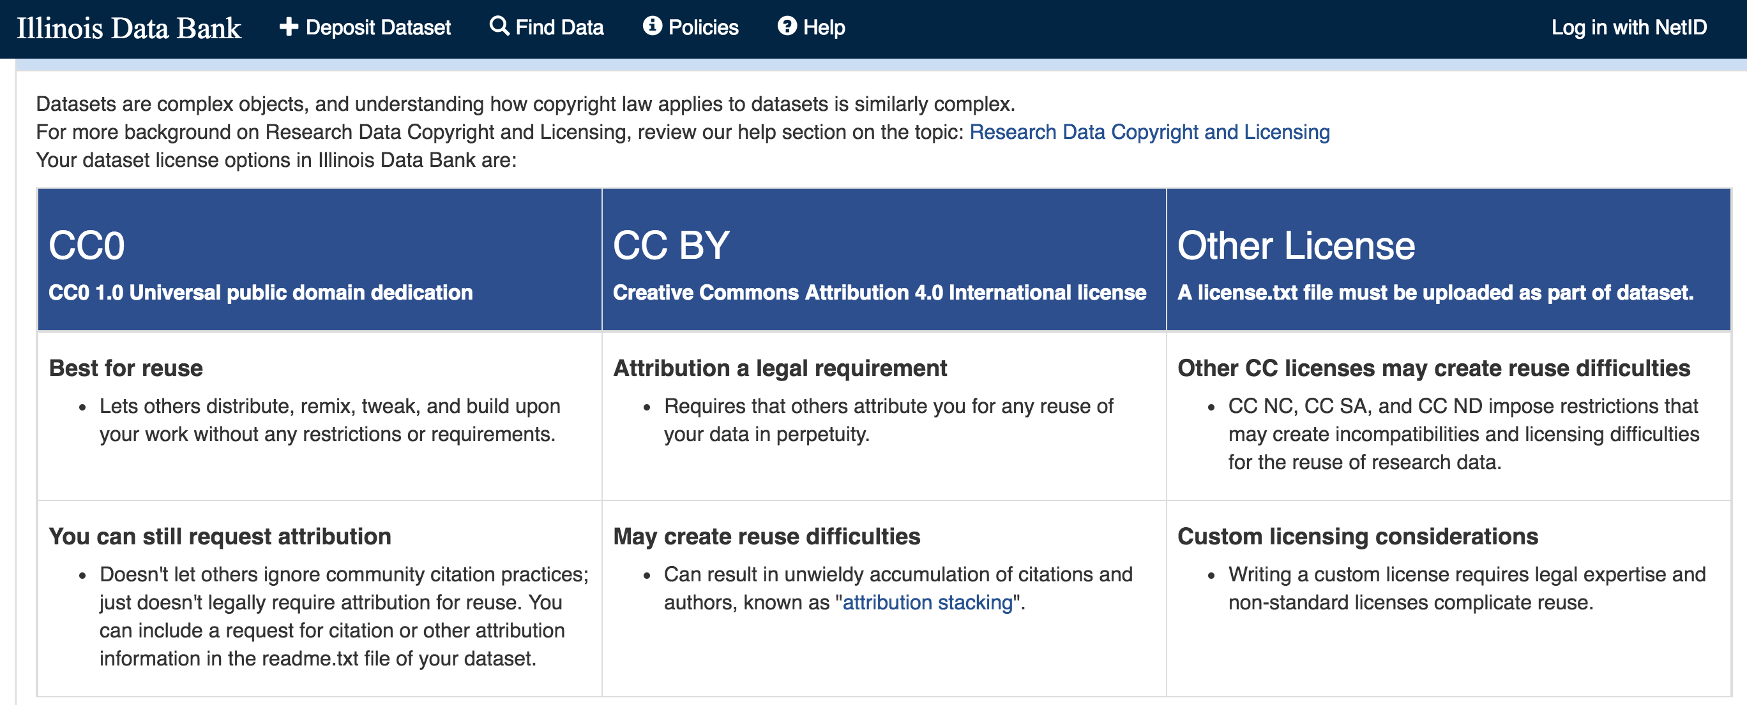
Notes:
In the real world…
Our good friends at the university of Illinois...
CC0

Slide 9
The Citation Advantage for Open Data
“In a multivariate regression on 10,555 studies that created gene expression microarray data, we found that studies that made data available in a public repository received 9% (95% confidence interval: 5% to 13%) more citations than similar studies for which the data was not made available. ”
Piwowar, Heather A., and Todd J. Vision. "Data reuse and the open data citation advantage." PeerJ 1 (2013): e175.
Notes:
There are many advantages to publishing open data – for instance a very clever study in 2013 by my colleague Heather piwowar – showed that papers making their underlyng data available receive almost 9% more citations that similar studies without open data…

Slide 10
But…
Many data sources can’t be completely “OPEN”
Copyright restrictions: HathiTrust
Confidential subjects / personal privacy : QualiBank in UK
Data Sharing agreements: EpiGen or Correlates of WAR project

Slide 11
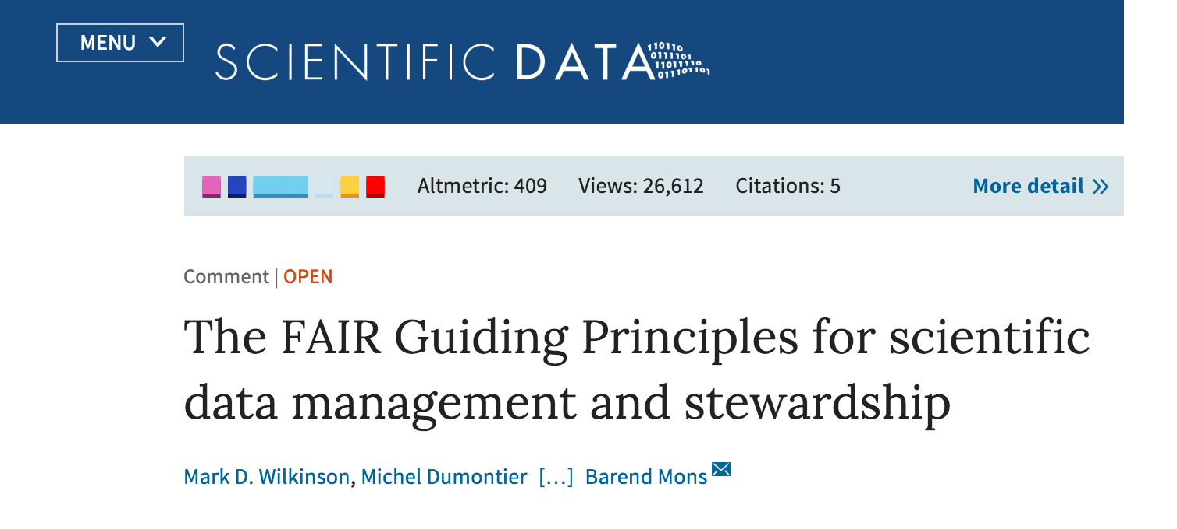
Findable, Accessible, Interoperable and Reusable
Notes:
Instead of making distinctions between open vs closed… I think its much more useful to think about data being FAIR - that is Findable, Accessible, Interoperable, and Reusable... This avoids making distnictions about how fair data can be achieved... For instance... The HathiTrust makes data findable, interoperabile and resuable... But has restrictions on the way that data are accessed as a result of their being copyright restrictuions... Fair DATA we can think as having some varitation of adherence to these four dimmenions

Slide 12
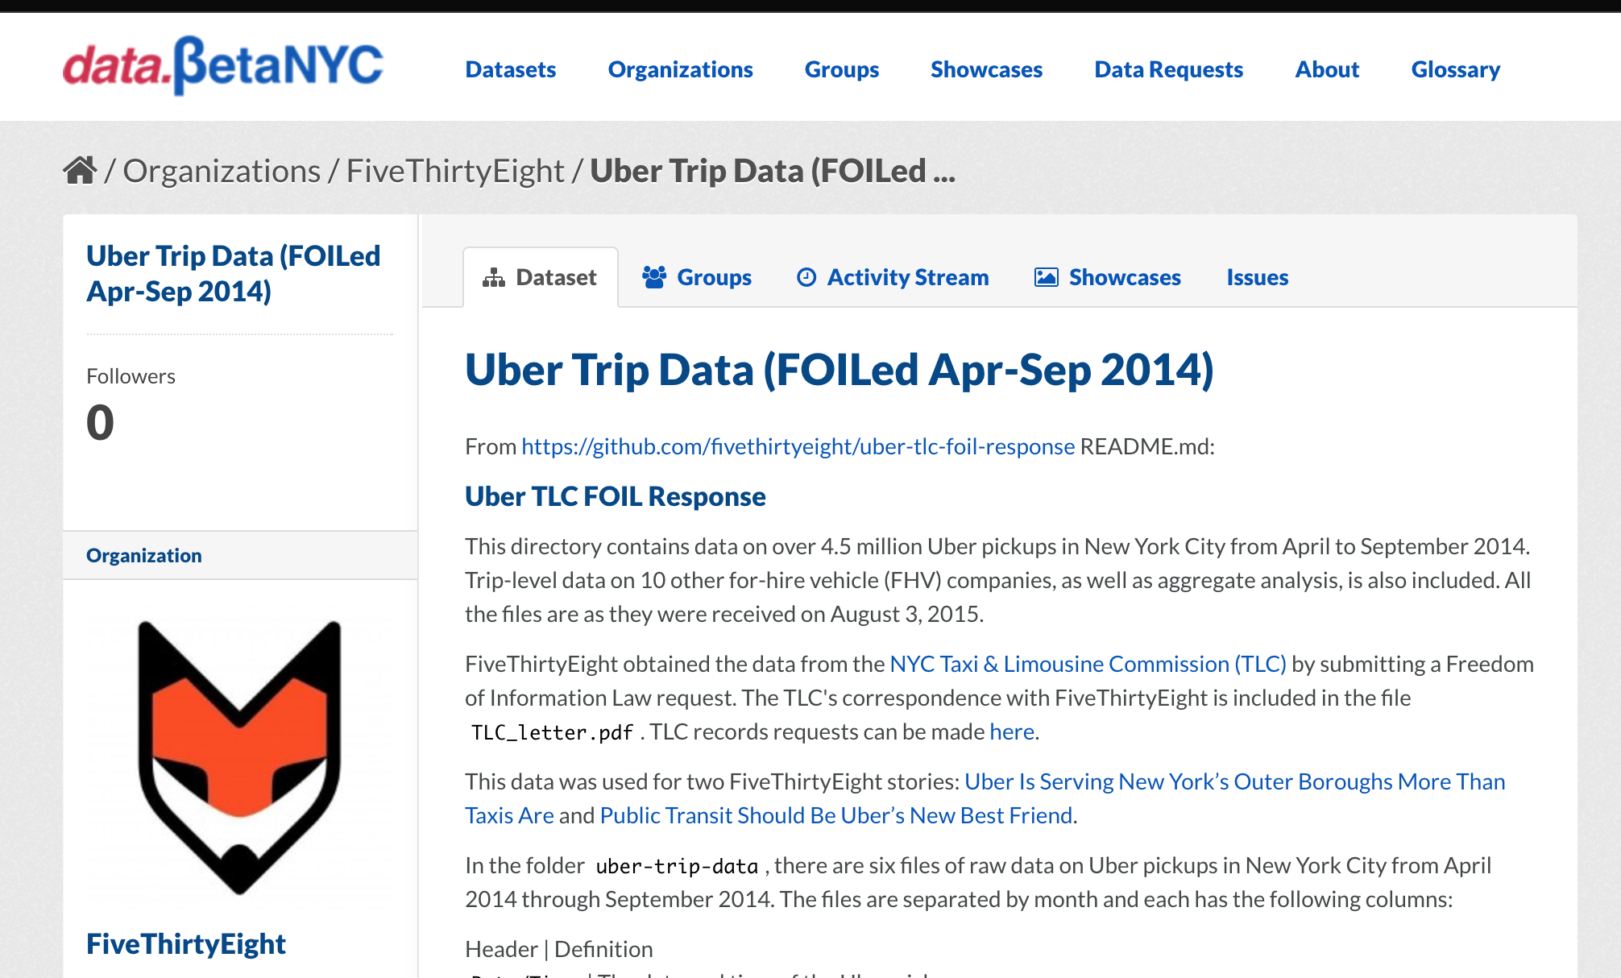
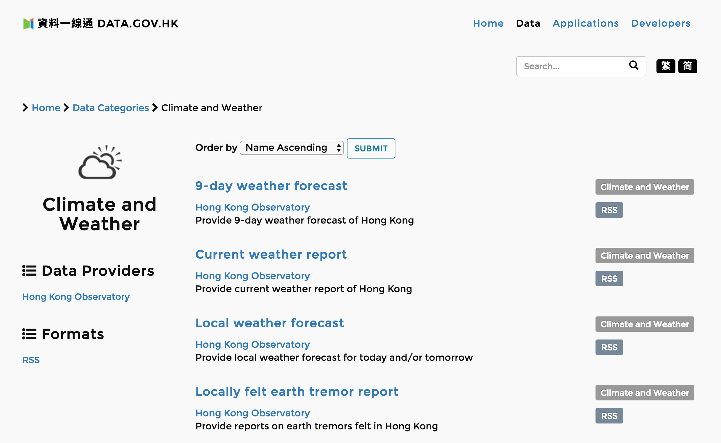
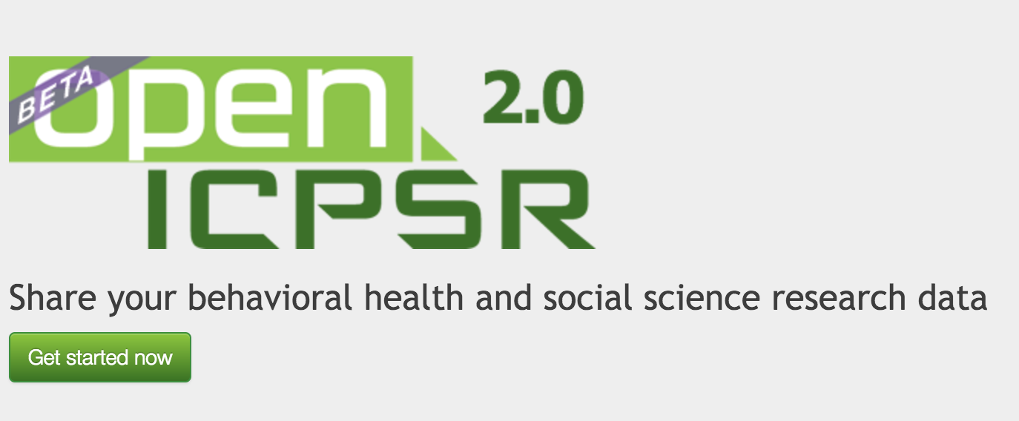
Academic, Private Sector, and Public Sector open data…
Notes:
And we can take this approach to fair data across a number of different sectors… for instance – Open Data in Sosical science in ICPSR...

Slide 13
Short Case Study: Open Data in Sensitive Context

Slide 14
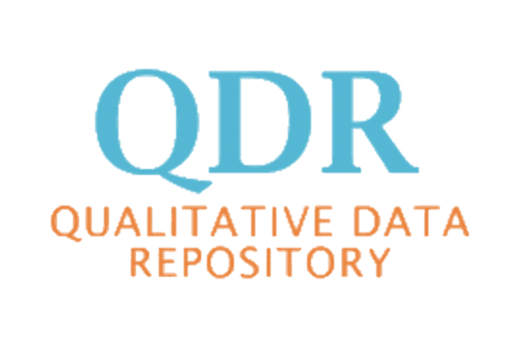
Short Case Study
Opened in 2014
Mission: To provide access to resources and materials underlying mixed methods, and qualitative research, and develop tools to help qualitative scholars protect privacy and confidentiality of subjects while simultaneously sharing their data.
Collaborators at Syracuse University, Georgetown University and the University of Washington

Slide 15
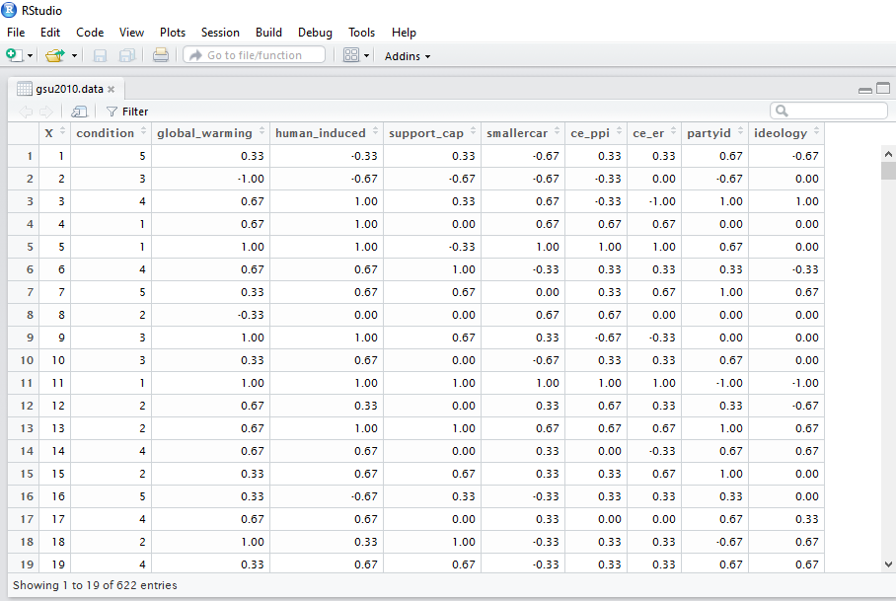


Quantitative Research: Matrix Data
Toby Bolsen, Thomas J. Leeper, and Matthew Shapiro. 2014. “Doing What Others Do: Norms, Science, and Collective Action on Global Warming.” American Politics Research 42(1): 65–89.

Slide 16
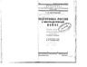
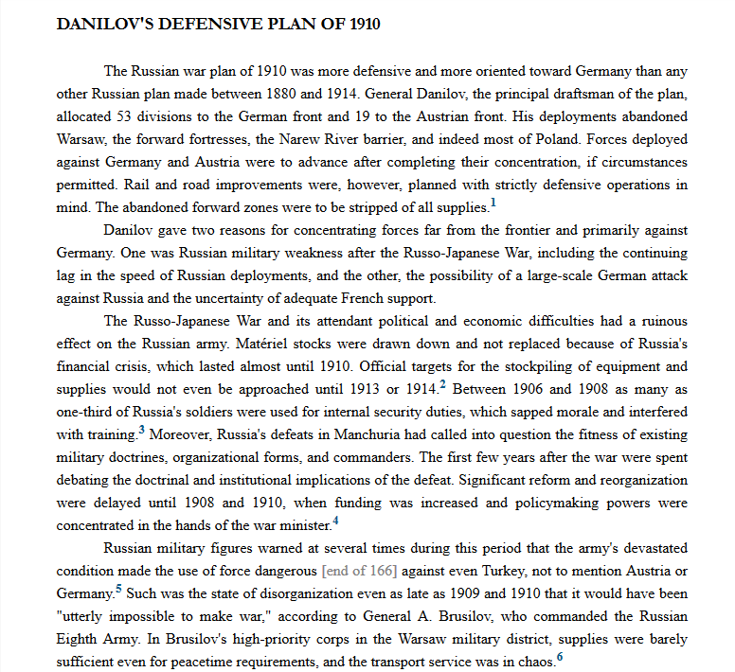

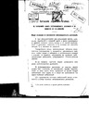
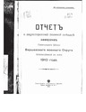
Qualitative Research: Granular Data
Analysis
Analysis
Analysis
Analysis

Slide 17
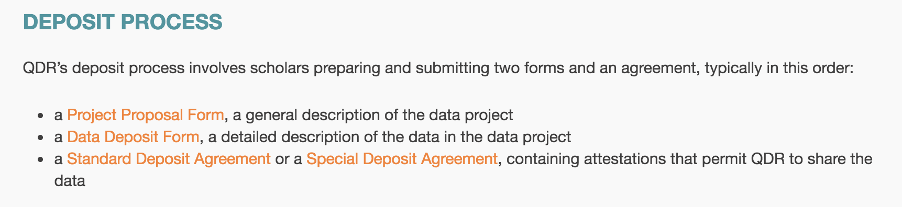
Three step data deposit process
Notes:
PPF
DDF
Standard Deposit agreement

Slide 18
Up Front Checks: Data Sharing and Ethical Concerns
Research must be designed, reviewed, and undertaken to ensure integrity, quality, and transparency
Any promises for confidentiality and/or anonymity respondents must be respected
Participation is voluntarily, free of any coercion
Harm to participants must be avoided in all instances
Any conflicts of interest must be explicit
Notes:
At each step – our curation team works with data depositors to ensure that the permission they have to archive material is correct…
That items they may want to deposit are not going to expose information about the subjects they have studied...

Slide 19
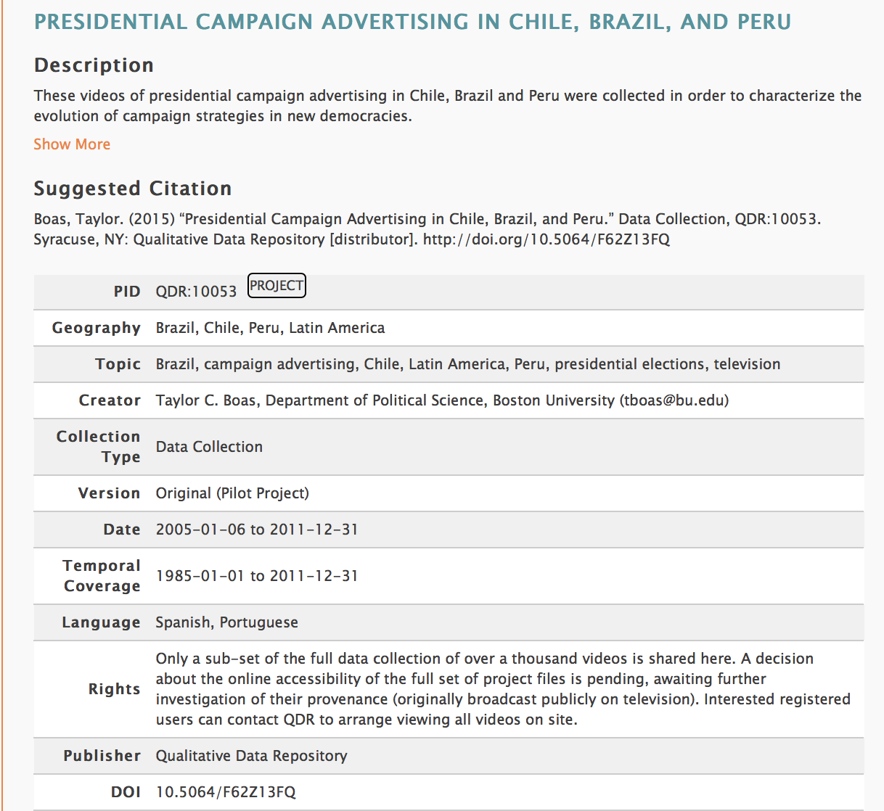
Sample QDR catalogue record metadata: Role-based permissions
Notes:
Role-based permissions
FAIR principles…
We make data collections Findable by publishing proect information pages like this... Expsoign basic metadata about a project...
We make data interpoperable in that we post plain text, open formats of all files that submitted to QDR
But like the HathiTrust - we do resitrct access to the actual files themselves... In particular we create what we call role-based permission strutures – that are established by data depositors saying who should have access, when, and under what circumstances...
So for instance – this is a project by tyler boas – a soscial scientist at Princeton. He deposited this dataset with us as a supplement to a journal publication... He wanted the reviewers of his manuscript to be able to view and access this data... But he did not want anyone else to be able to download the data without contacting him first... So we establsih role based permissions that say who can play what role... Maybe Stephen can play the reiviewer role and he can download alll data.... Maybe Eleanor plays a general user role and she has to contact Tyler before she can download the dataset.

Slide 20
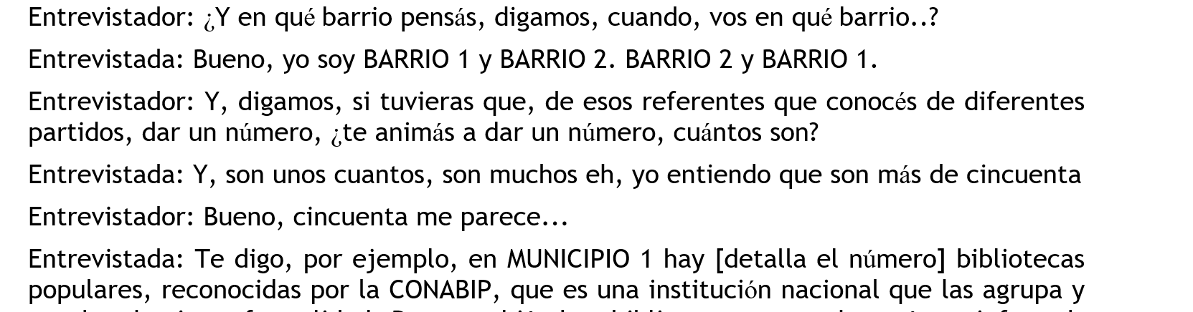
Publishing Sensitive Data: Quantitative vs. Qualitative Techniques
Quantitative: Technical solutions (differential privacy, masking, synthetic data, multi-party computing)
Manual anonymization: researcher knowledge
Notes:
REMMBER that FAIR data requires Findable Accessible Interoperable.. And Reusable…
At QDR – we also provide resuable data in a few manual forms…
When we have data that contain personally idnetifiable information... Such as the names, addresses, phone numbers etc. Of individuals we manually strip those out or redact them... For instance – in this transcript we see Bario – the neighborhood of this individual has been altered so that the person cannot be identified...

Slide 21
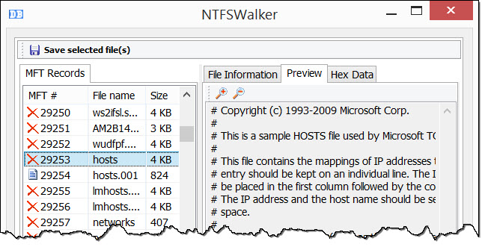
Data destruction
Notes:
WE also help make data inaccessible…
For some of our depositors who transfer management of their data to QDR – they are required by law to delete any other copies...so we have a few tools and protocols which we use to help depositors make sure they have properly deleted al data from their machines...
PAUSSE FOR QUESTIONS...

Slide 22
Data Publication
Notes:
Imma shift gears…

Slide 23
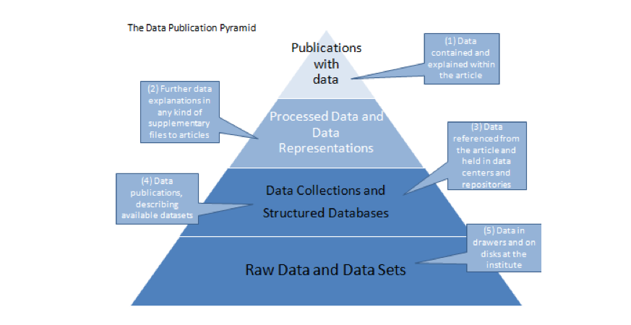
Data Publication Pyramid
http://www.alliancepermanentaccess.org/wp-content/uploads/downloads/2011/11/ODE-ReportOnIntegrationOfDataAndPublications-1_1.pdf
Notes:
Data publication we can think about building off a base of raw data…
At highest level we may have publications such as a jorunal article with underlying data published on the web...

Slide 24
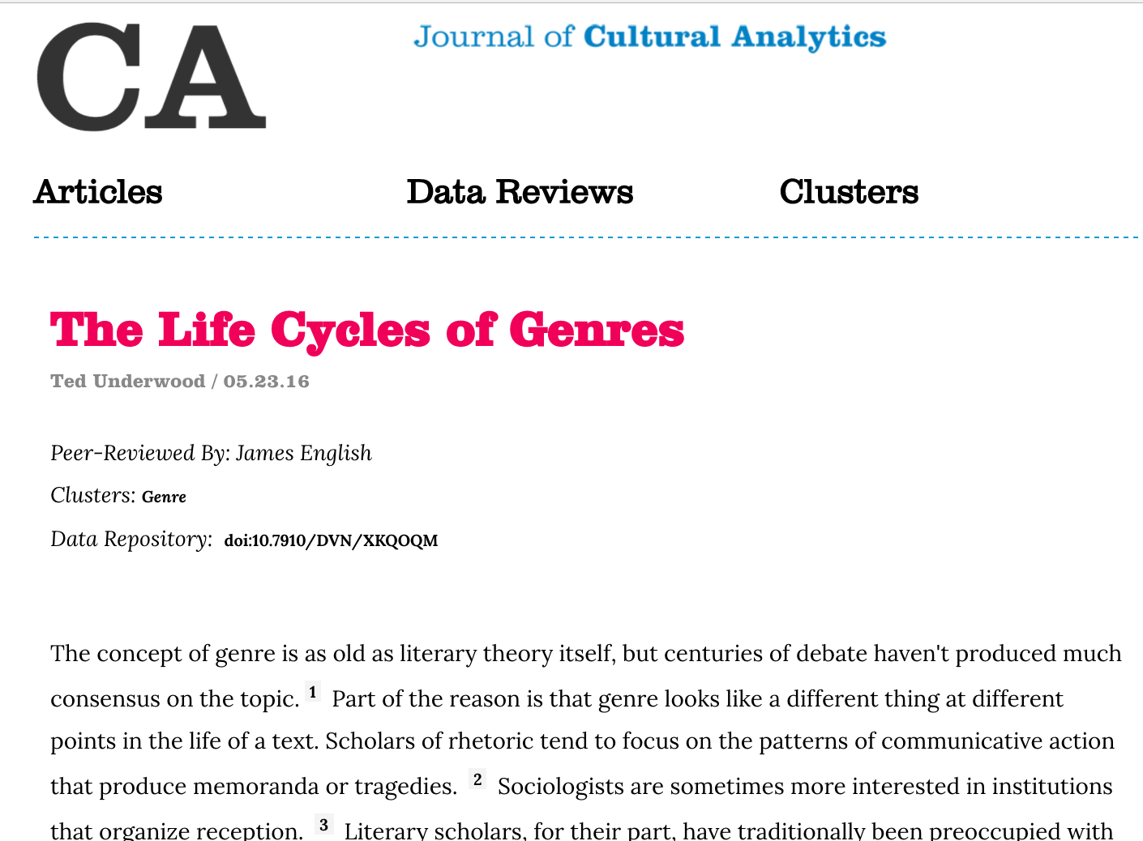
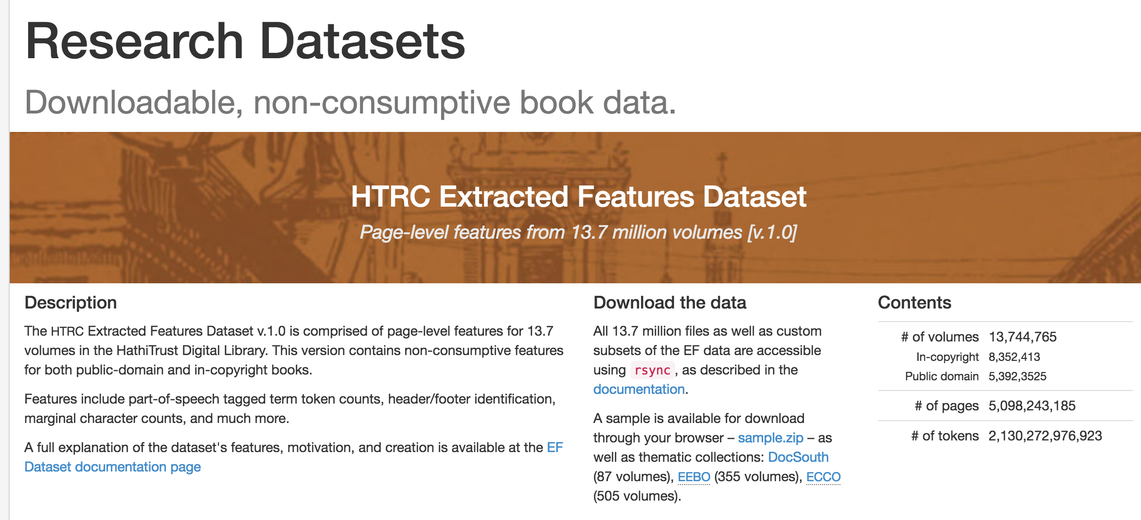

Notes:
Let’s look at this concept from the example of HathiTRUST that we’ve talked about yesterday….

Slide 25
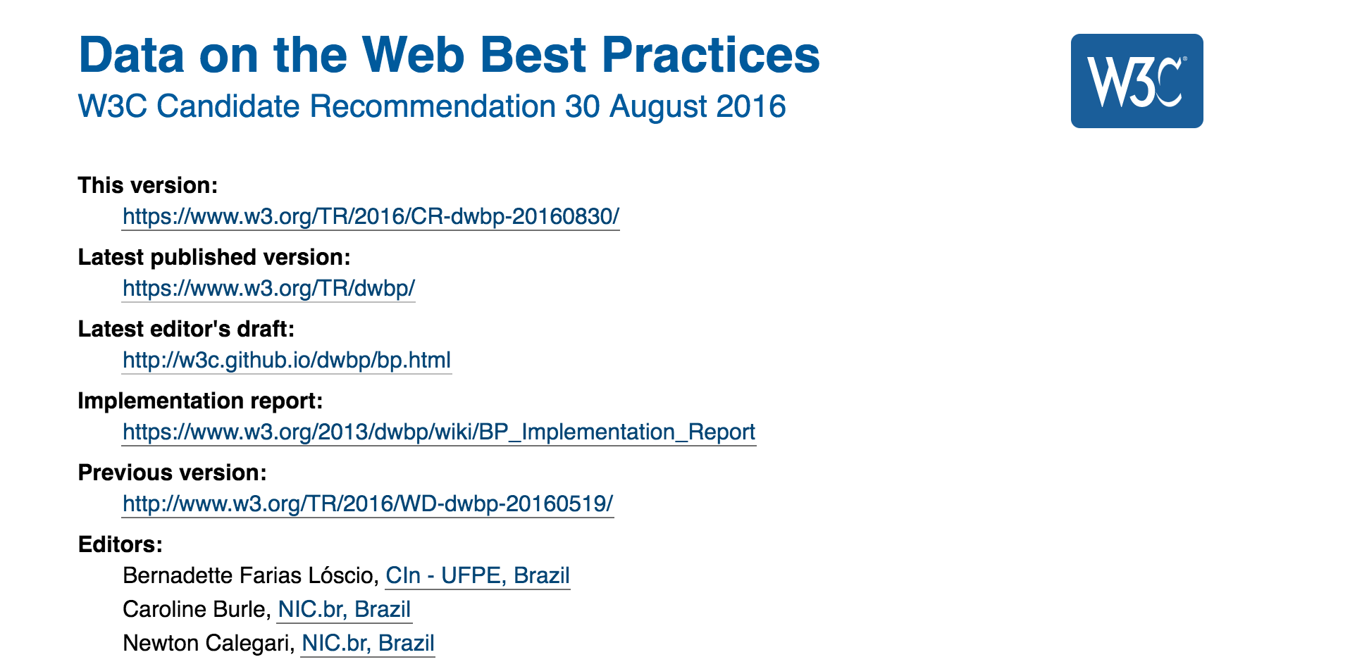
Publishing data on the web: Standards
Notes:
Publishing data on the wEB – a set of recommendations from the World Wide Web Consortium – making stnadrds for the web….
They desribe three forms of data publication... And one mechanism for certification of a data publisher...

Slide 26
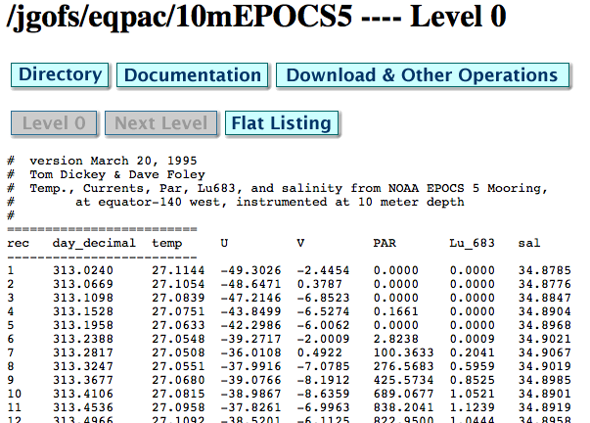
Publishing data on the web: Directory
Notes:
First

Slide 27
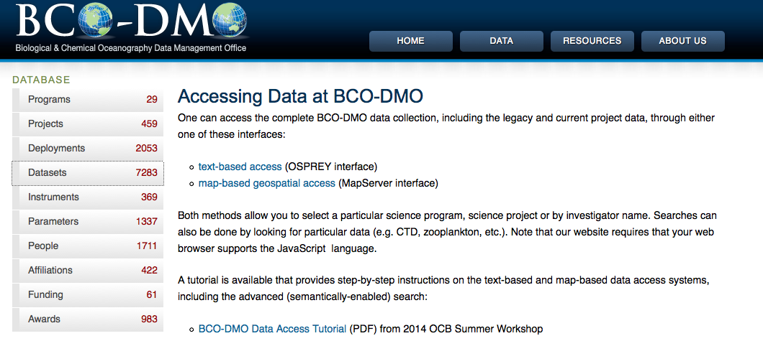
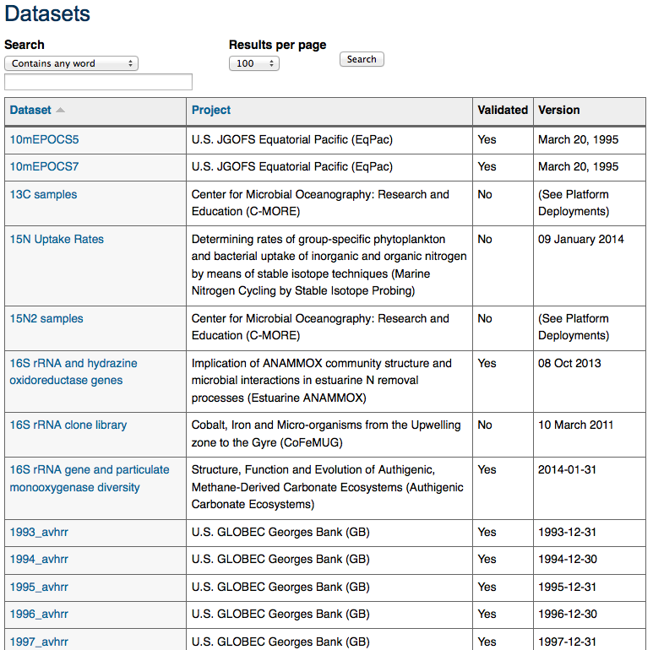
Publishing data on the web: Structured information page
Notes:
Second…
What is good about this … ?
Discoverable – lots of information, customizable
What is bad about this approach…
It is incredibly labor intensive, takes much

Slide 28
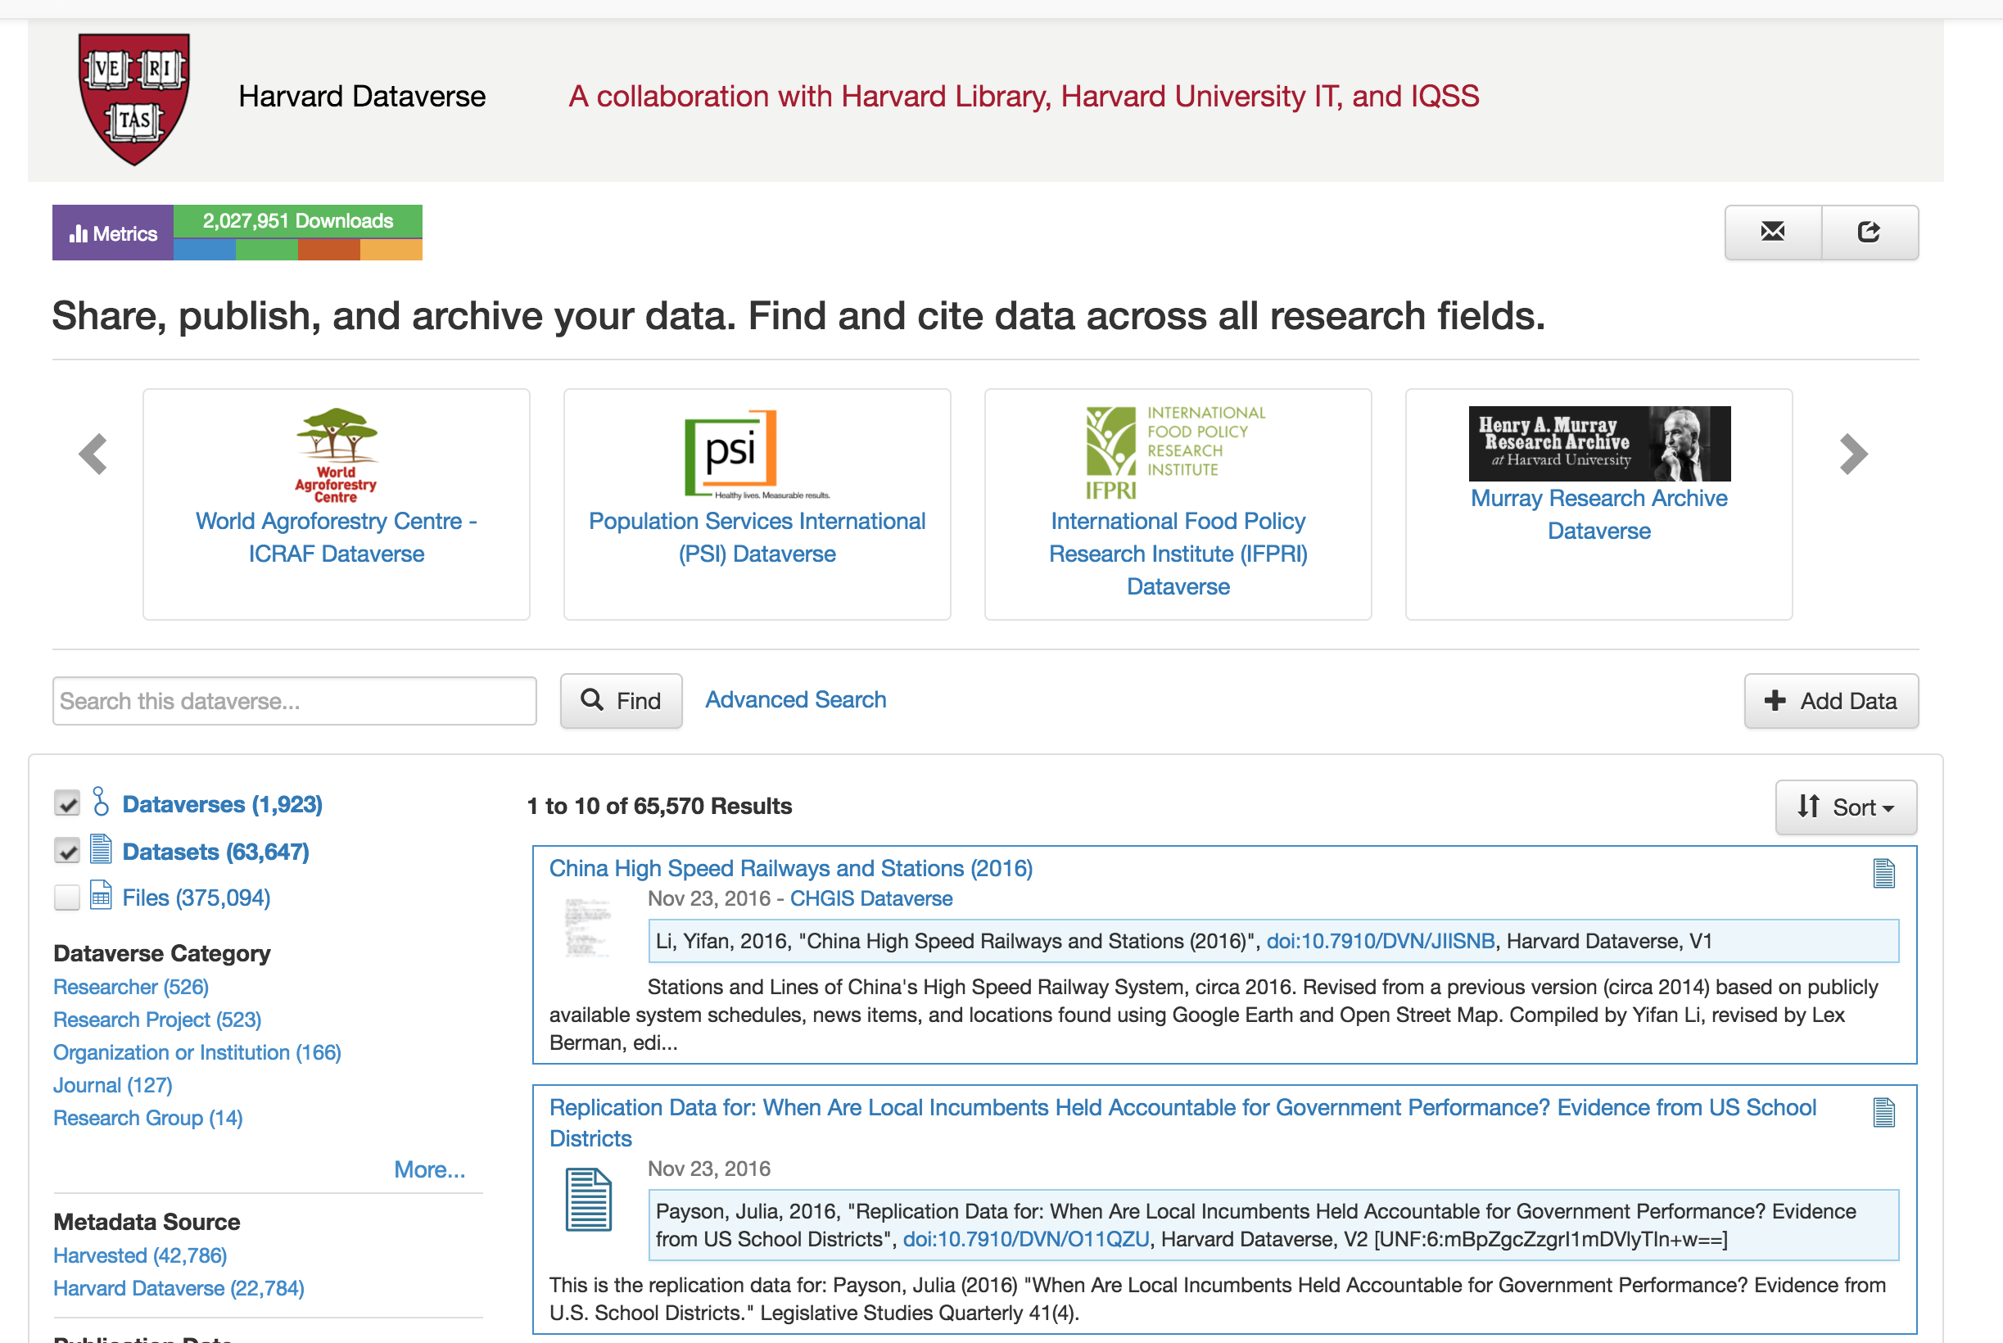
Publishing data on the web: Repository
Notes:
Third…
Probably the best

Slide 29
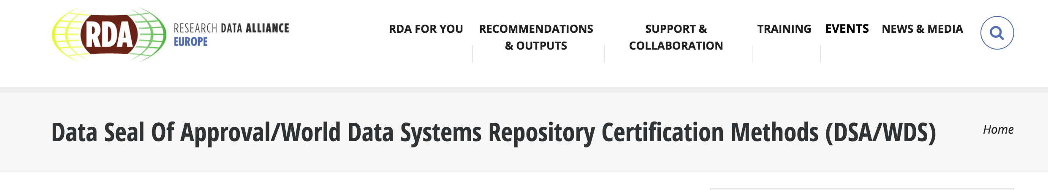
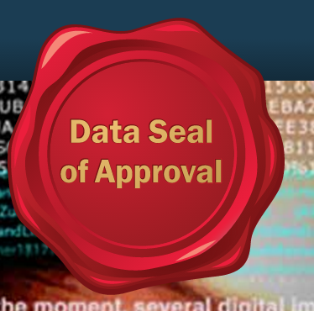
Publishing data on the web: Trusted Digital Repositories
Notes:
Cenral to

Slide 30
Identifiers + Attribution
Notes:
Central to all publishing of data is the ability ot identify - that is pick sutff out – and reliably locate stuff on the web…

Slide 31
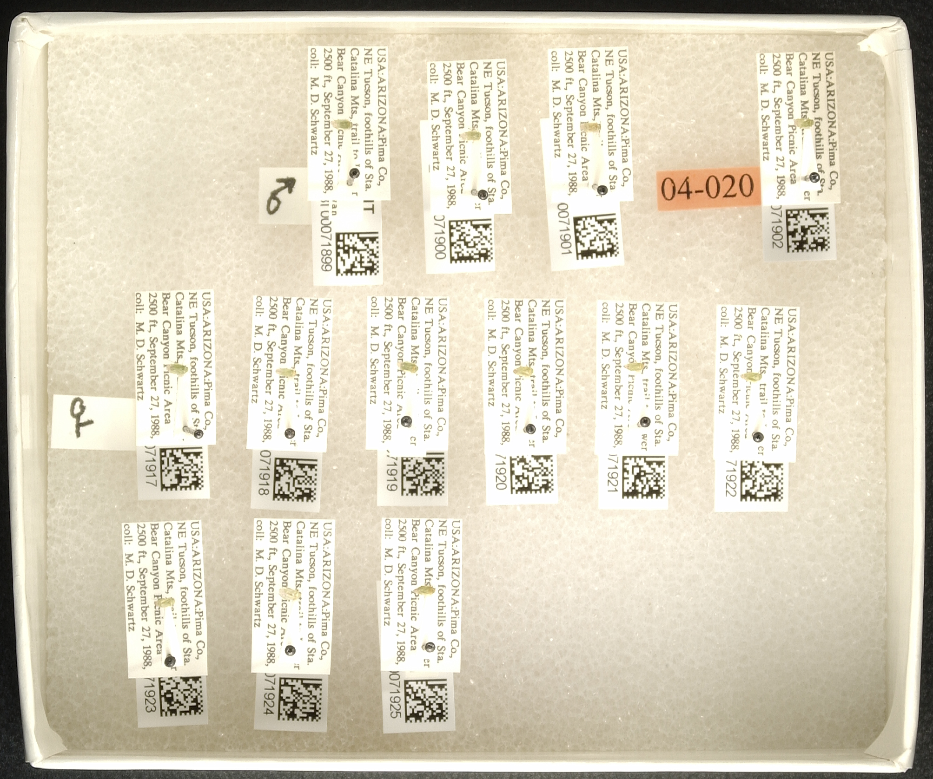
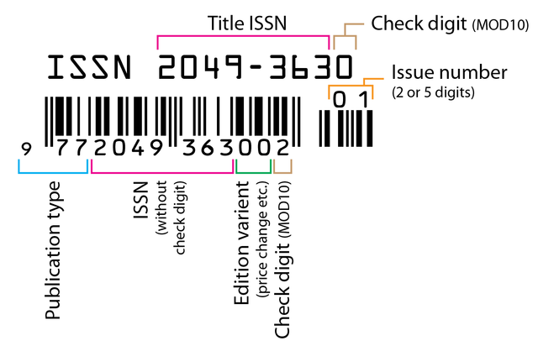
Identifiers are everywhere

Slide 32
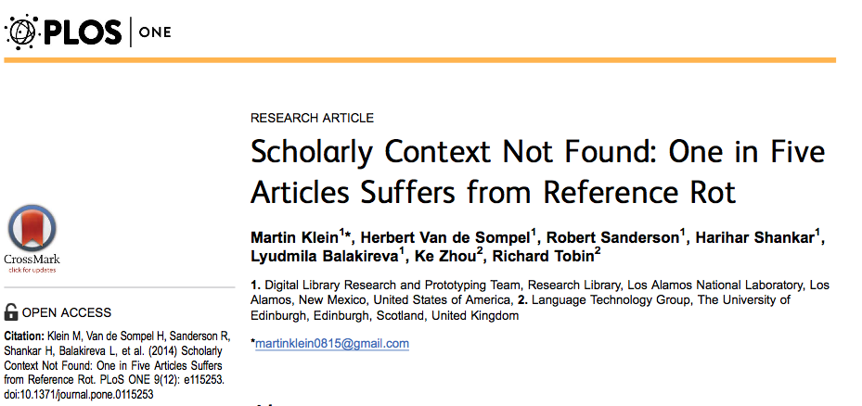
Why IDs matter for data driven scholarship?
Test corpus: 3.5 million scholarly articles published 1997-2012
20% had web content that was not accessible for review (e.g. link rot, content drift)
If data are playing a role of evidence… we need to make sure that they are stable and accessible for the long-term
Notes:
Explain link rot and content drift
combination of link rot and content drift to which references to web resources included in Science, Technology, and Medicine (STM) articles are subject. W

Slide 33
How do identifiers help with attribution?
Published data is institutionalized data sharing…
Receive MORE citations than 99% of traditional publications
(for Oceanography (Belter, 2014)
…more likely to be reused in high impact studies (Mayernik et al., 2013)
Increases ability to build knowledge, and reputation (Wallis, et al 2012)
Provides a citation advantage for related literature (Piwowar and Vision, 2013)
Notes:
And identifiers help to do a few things like…

Slide 34
Qualities of an ID for data curation
Machine Readable
Unique
Persistent
Resolvable

Slide 35
Values of different ID schemes
Technical value: assessing the technology underlying the identifier scheme;
User value: assessing how the scheme is likely to make end user’s lives easier or more difficult; and
Archive value: assessing whether an identifier scheme is likely to make the job of data management easier or more complicated
Duerr, et al. 2011

Slide 36
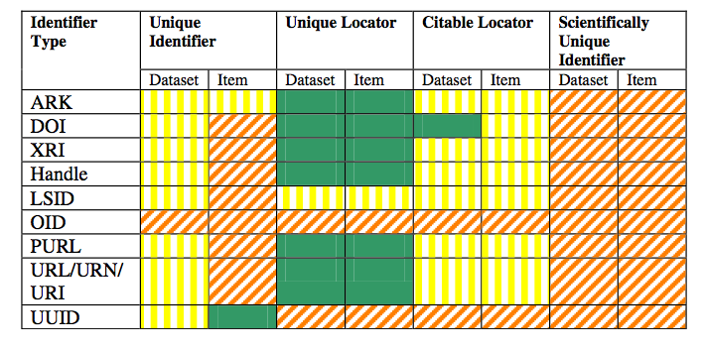
Evaluating different ID schemas

Slide 37
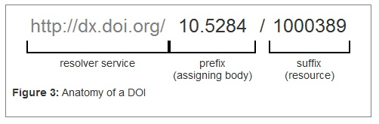
What is a DOI ?
Reference?
Notes:
Spend time talking about what the doi does
It resolves to a landing page… and even though the resorce might change, the doi doesn’t – so we can move doi to continue to point at the resource… (I obviously do not know how this works)

Slide 38
An ID alone isn’t enough
ID’s are pointers – they need to point to something
Just as an address won’t prevent a house from being demolished or remodeled, an ID will not prevent “content drift” or data from being deleted
They don’t make content more reliable, citable, or trustworthy

Slide 39
Finally: Data objects “version” differently
Books: volumes, editions, issues
Software: versions, builds
Datasets: are sometimes versioned, but often accrete or change gradually over time
Identifier management must coincide with data management, project management, and creation of good documentation

Slide 40
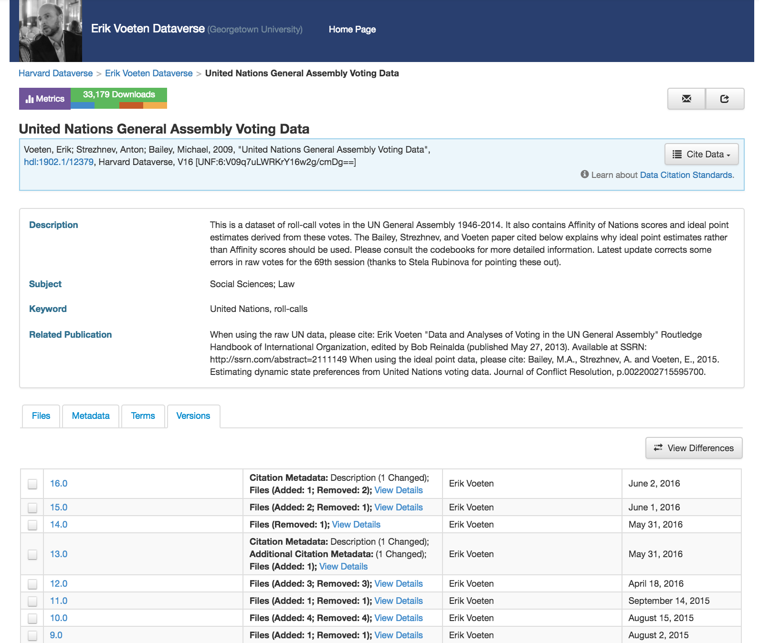

Slide 41



DOI services differ
But not ideal

Slide 42
Tracking published data use

Slide 43
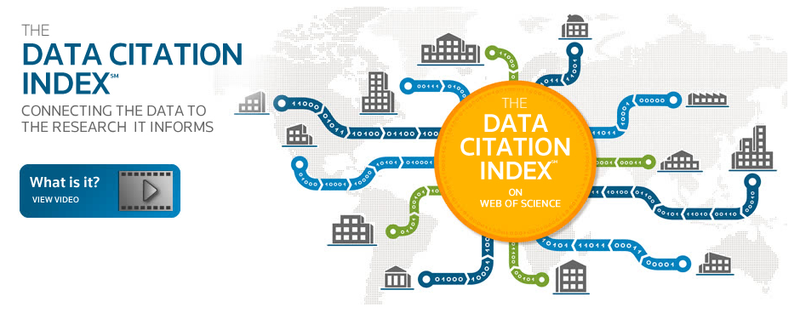
How do we measure, evaluate, or track data use?
Traditional bibliometric methods

Slide 44
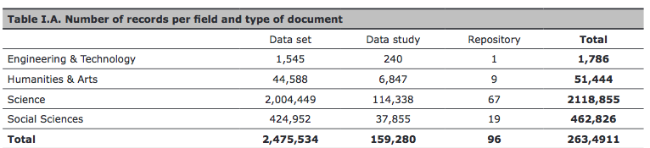
Coverage (poor)
Salinas et al (2015) An introduction to the coverage of the Data Citation Index (Thomson-Reuters): disciplines, document types and repositories
https://arxiv.org/abs/1306.6584
Notes:
2012 study that looked at the coverage – (in short, very poor)

Slide 45
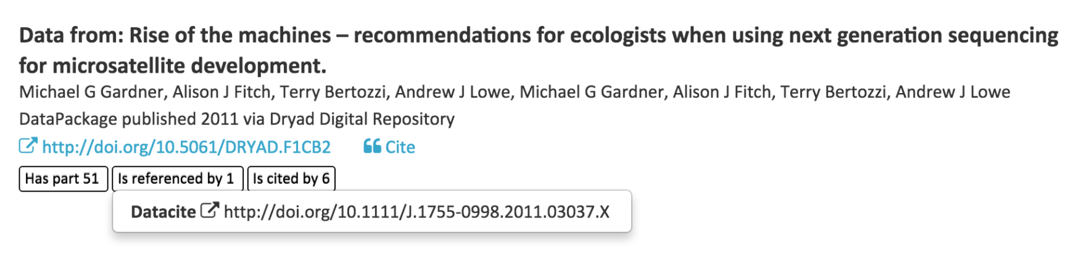
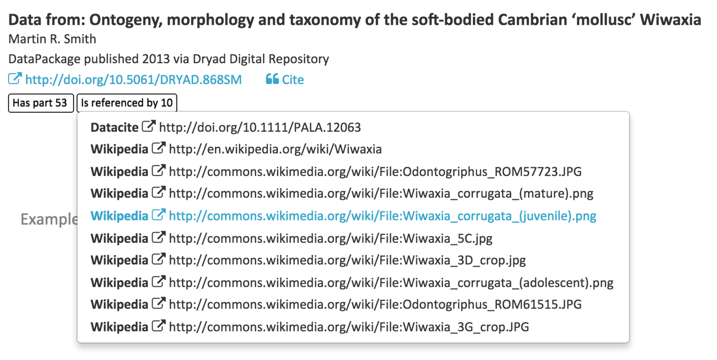
How do we measure, evaluate, or track data use?
Emerging methods – Trace DOIs by scraping the web
https://blog.datacite.org/announcing-data-level-metrics-in-datacite-labs/

Slide 46
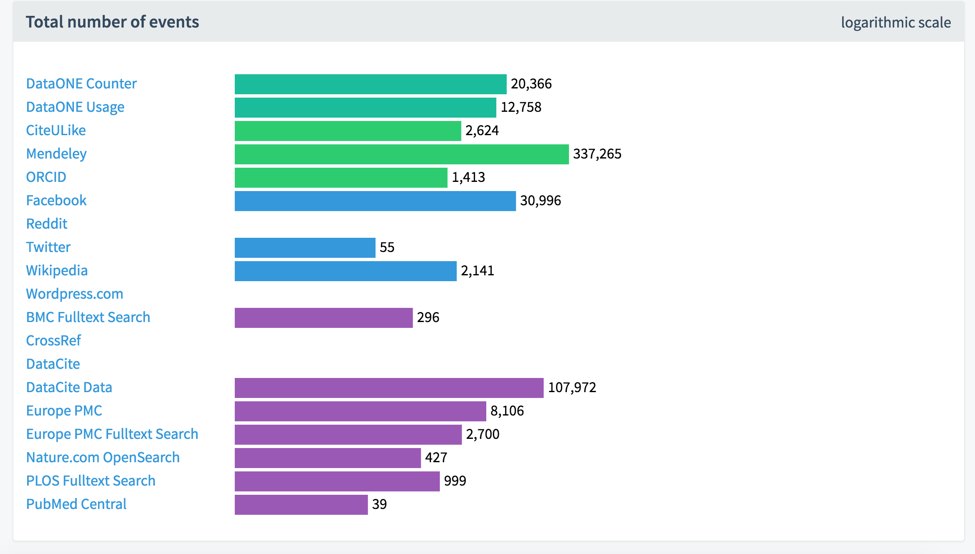
https://dlm.datacite.org/

